Slide 1
Introduction to Molecular Dynamics
SHUG-2015
Jose M. Borreguero & Vickie E. Lynch
Neutron Data Analysis and Visualization Division
Center for Accelerating Materials Modelling

Slide 2
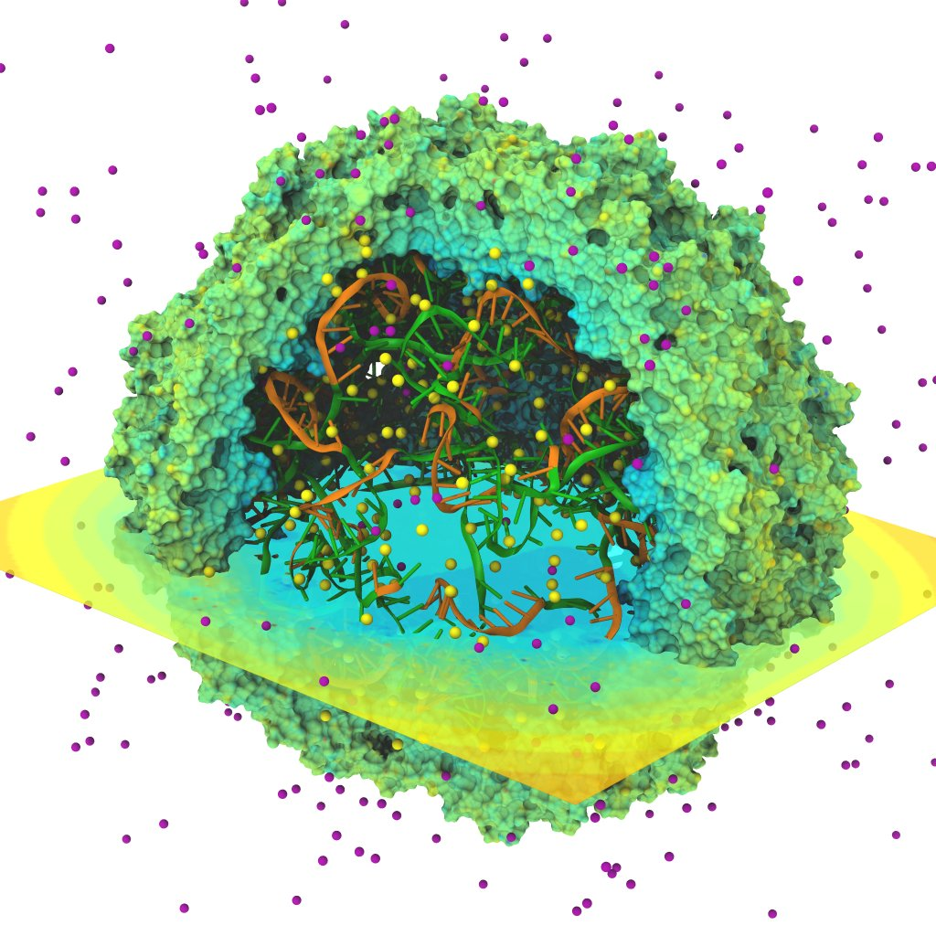
Outline
Minimal requirements
Ab initio MD
Derivation of a classical FF

Slide 3

Minimal Requirements to Run a Simulation
A Hamiltonian (Force-Field)
An environment for the system
Heat bath
Pressure bath
Boundary conditions
A starting conformation for every particle in the system:
Coordinates
Velocities
A solver of Newton’s equations for the system
Specify which quantities to compute
Time-evolution of coordinates
Thermodynamic quantities (T, P, V, density)
Evaluation of the potential terms

Slide 4
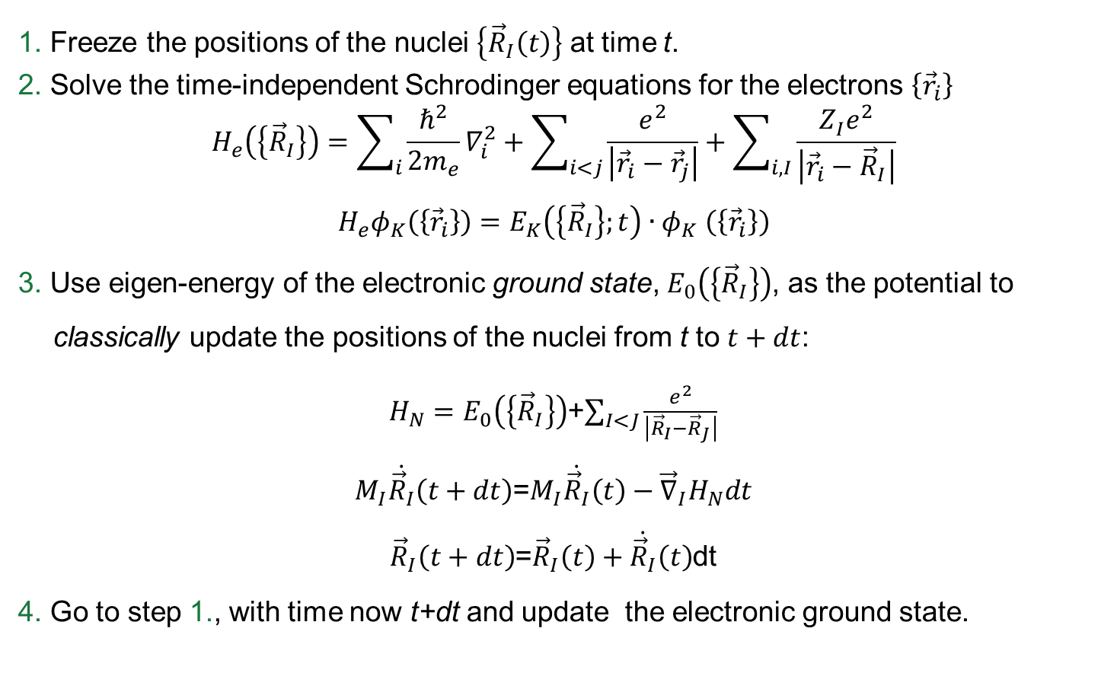
MD in the Born-Oppenheimer approx.
1. Freeze the positions of the nuclei $\left\{{\vec{R}}_{I}\left(t\right)\right\}$ at time t.
2. Solve the time-independent Schrodinger equations for the electrons $\left\{{\vec{r}}_{i}\right\}$
$$H_{e}\left(\left\{{\vec{R}}_{I}\right\}\right)=\sum_{i}{\frac{ℏ^{2}}{2m_{e}}∇_{i}^{2}}+\sum_{i<j}{\frac{e^{2}}{\left|{\vec{r}}_{i}−{\vec{r}}_{j}\right|}}+\sum_{i,I}{\frac{{Z_{I}^{}e}^{2}}{\left|{\vec{r}}_{i}−{\vec{R}}_{I}\right|}}$$
$$H_{e}φ_{K}\left(\left\{{\vec{r}}_{i}\right\}\right)=E_{K}\left(\left\{{\vec{R}}_{I}\right\};t\right){∙φ}_{K}\left(\left\{{\vec{r}}_{i}\right\}\right)$$
3. Use eigen-energy of the electronic ground state, $E_{0}\left(\left\{{\vec{R}}_{I}\right\}\right)$, as the potential to classically update the positions of the nuclei from t to $t+dt$:
$H_{N}=E_{0}\left(\left\{{\vec{R}}_{I}\right\}\right)$+$\sum_{I<J}{\frac{e^{2}}{\left|{\vec{R}}_{I}−{\vec{R}}_{J}\right|}}$
$M_{I}\dot{{\vec{R}}_{I}}\left(t+dt\right)$=$M_{I}\dot{{\vec{R}}_{I}}\left(t\right)−{\vec{∇}}_{I}H_{N}dt$
${\vec{R}}_{I}\left(t+dt\right)$=${\vec{R}}_{I}\left(t\right)+\dot{{\vec{R}}_{I}}\left(t\right)$dt
4. Go to step 1., with time now t+dt and update the electronic ground state.

Slide 5
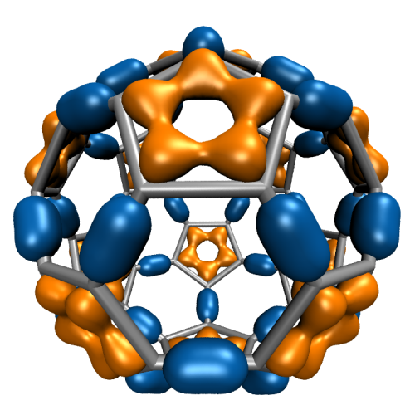
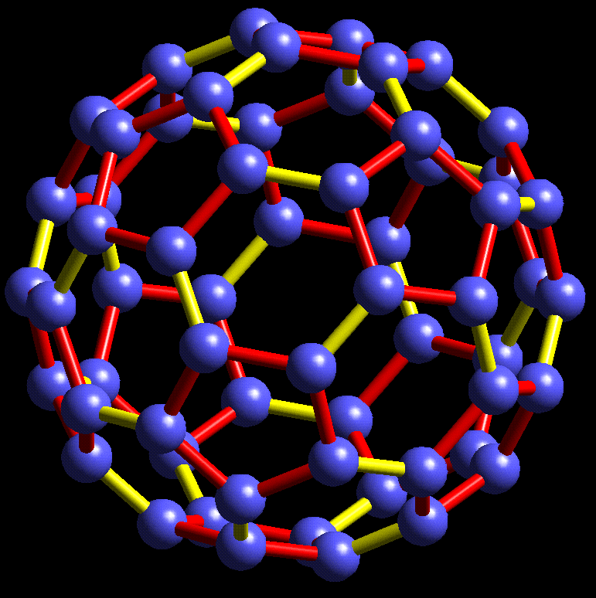
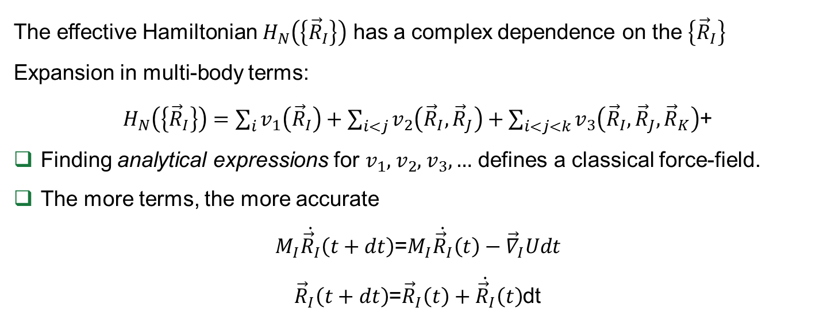
The classical Force-Field (FF)
The effective Hamiltonian $H_{N}\left(\left\{{\vec{R}}_{I}\right\}\right)$ has a complex dependence on the $\left\{{\vec{R}}_{I}\right\}$
Expansion in multi-body terms:
$H_{N}\left(\left\{{\vec{R}}_{I}\right\}\right)=\sum_{i}{v_{1}\left({\vec{R}}_{I}\right)}+\sum_{i<j}{v_{2}\left({\vec{R}}_{I},{\vec{R}}_{J}\right)}+\sum_{i<j<k}{v_{3}\left({\vec{R}}_{I},{\vec{R}}_{J},{\vec{R}}_{K}\right)}$+
Finding analytical expressions for $v_{1}$, $v_{2}$, $v_{3},…$ defines a classical force-field.
The more terms, the more accurate
$M_{I}\dot{{\vec{R}}_{I}}\left(t+dt\right)$=$M_{I}\dot{{\vec{R}}_{I}}\left(t\right)−{\vec{∇}}_{I}Udt$
${\vec{R}}_{I}\left(t+dt\right)$=${\vec{R}}_{I}\left(t\right)+\dot{{\vec{R}}_{I}}\left(t\right)$dt
A Force-Field bypasses calculation of the electronic ground state at each time step!

Slide 6
Introduction to AMBER FF
SHUG-2015
Jose M. Borreguero
Neutron Data Analysis and Visualization Division
Center for Accelerating Materials Modelling

Slide 7
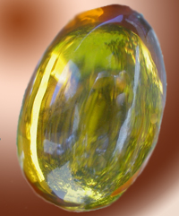
A bit of general info
http://ambermd.org
The AMBER MD group hosts three independent packages
equation solver + system environment ($$$)
various force-fields (free)
analysis tools (free)
Yearly releases

Slide 8
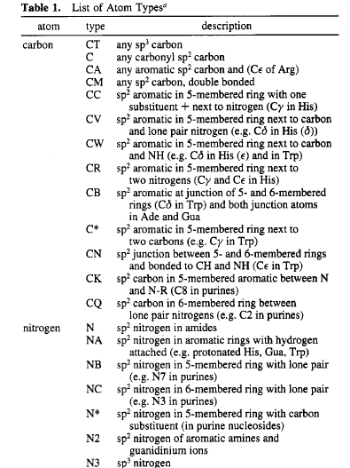
Atom types
Nuclei → Atoms with properties dependent on their chemical environment
1 element, many types !
Orb. hybridization → number of covalent bonds
polarization → fractional valence charges
charge fluctuations → Van der Waals parms.

Slide 9
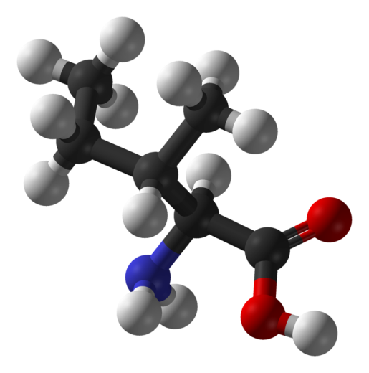
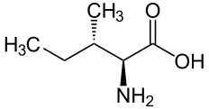
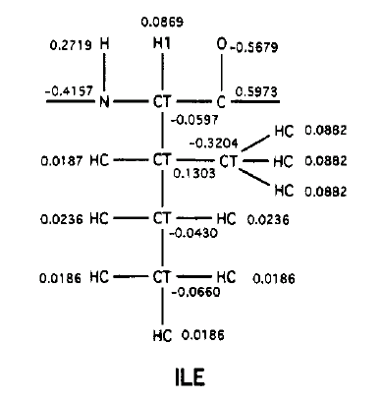
Atom types
Example: Isoleucine amino acid

Slide 10
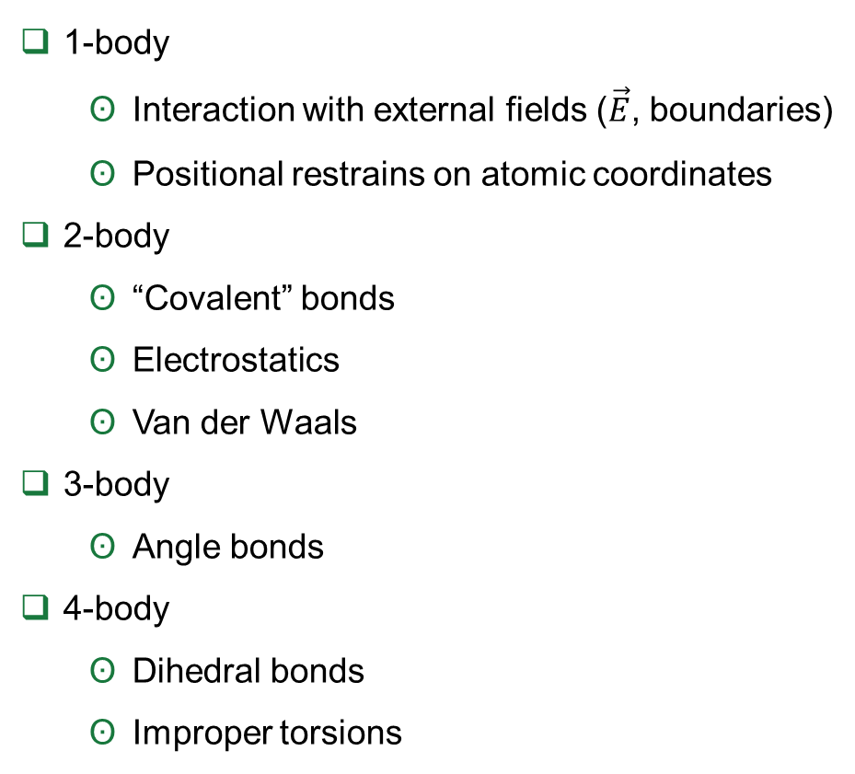
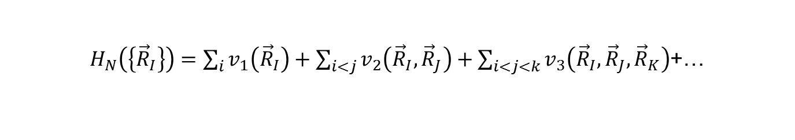
Expansion in multi-body terms
$H_{N}\left(\left\{{\vec{R}}_{I}\right\}\right)=\sum_{i}{v_{1}\left({\vec{R}}_{I}\right)}+\sum_{i<j}{v_{2}\left({\vec{R}}_{I},{\vec{R}}_{J}\right)}+\sum_{i<j<k}{v_{3}\left({\vec{R}}_{I},{\vec{R}}_{J},{\vec{R}}_{K}\right)}$+…
1-body
Interaction with external fields ($\vec{E}$, boundaries)
Positional restrains on atomic coordinates
2-body
“Covalent” bonds
Electrostatics
Van der Waals
3-body
Angle bonds
4-body
Dihedral bonds
Improper torsions

Slide 11
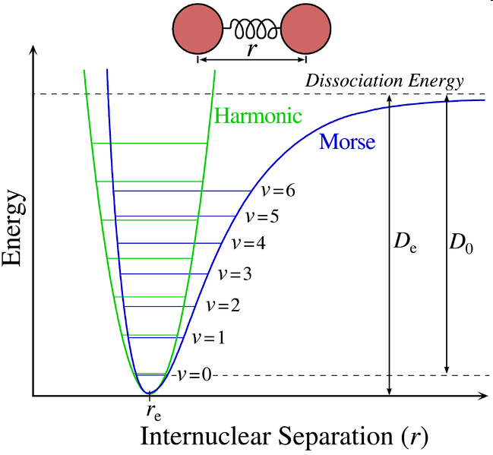
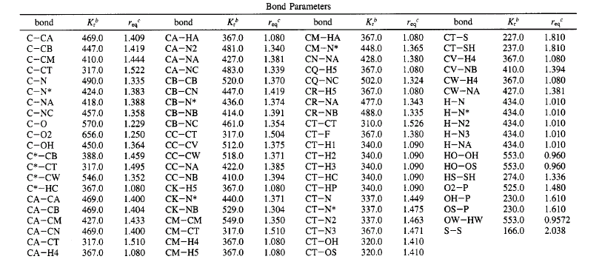
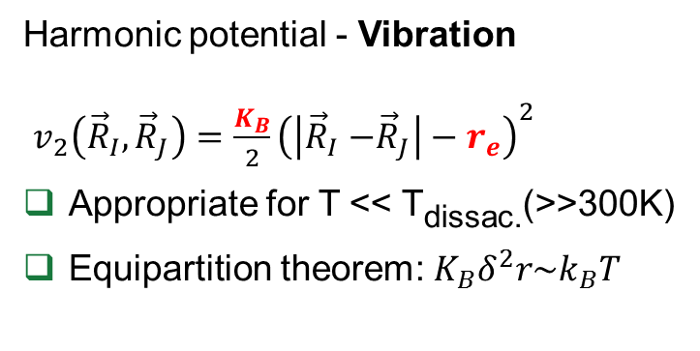
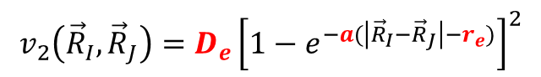
2-body: “covalent” bond
Harmonic potential - Vibration
$v_{2}\left({\vec{R}}_{I},{\vec{R}}_{J}\right)=\frac{K_{B}}{2}{\left(\left|{\vec{R}}_{I}{−\vec{R}}_{J}\right|−r_{e}\right)}^{2}$
Appropriate for T << T_{dissac.}(>>300K)
Equipartition theorem: $K_{B}δ^{2}r\sim k_{B}T$
For T << T_{dissac} use the Morse potential:
$$v_{2}\left({\vec{R}}_{I},{\vec{R}}_{J}\right)=D_{e}{\left[1−e^{−a(\left|{\vec{R}}_{I}{−\vec{R}}_{J}\right|−r_{e})}\right]}^{2}$$
Example of parameterization:
(Kcal/molÅ²)

Slide 12
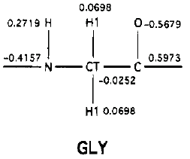
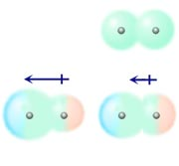
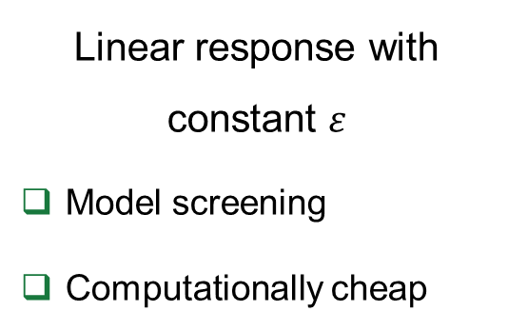
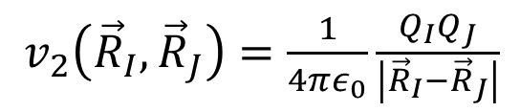
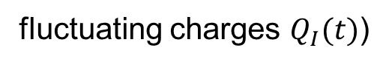
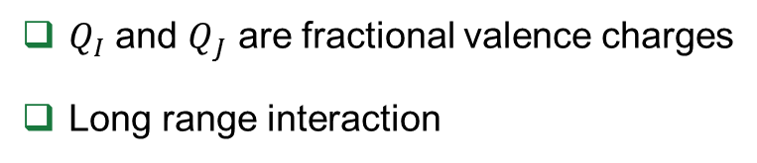
2-body: Electrostatics
$v_{2}\left({\vec{R}}_{I},{\vec{R}}_{J}\right)=\frac{1}{4πε_{0}}\frac{Q_{I}Q_{J}}{\left|{\vec{R}}_{I}{−\vec{R}}_{J}\right|}$
$Q_{I}$ and $Q_{J}$ are fractional valence charges
Long range interaction
Controls unbound diffusion
Models can get more complicated
fluctuating charges $Q_{I}(t)$)
Linear response with constant $ε$
Model screening
Computationally cheap
Computationally expensive

Slide 13
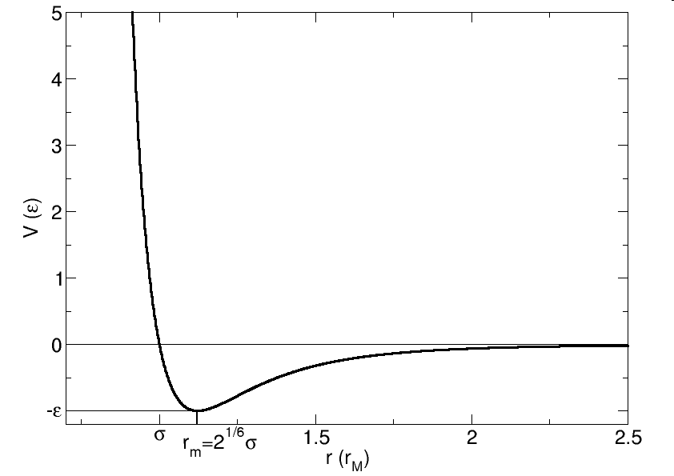
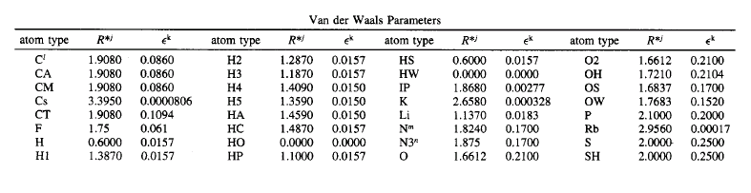
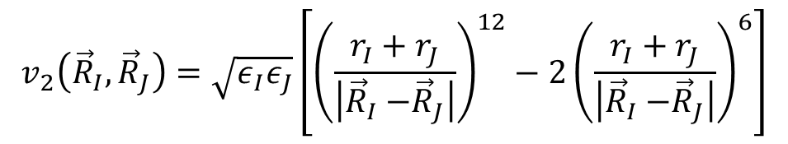
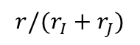
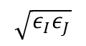
2-body: Van der Waals
$$v_{2}\left({\vec{R}}_{I},{\vec{R}}_{J}\right)=\sqrt{ε_{I}ε_{J}}\left[{\left(\frac{r_{I}+r_{J}}{\left|{\vec{R}}_{I}{−\vec{R}}_{J}\right|}\right)}^{12}−2{\left(\frac{r_{I}+r_{J}}{\left|{\vec{R}}_{I}{−\vec{R}}_{J}\right|}\right)}^{6}\right]$$
12-term ← electron cloud overlap
6-term ← fluctuating dipole-dipole interactions
short-range
$$\sqrt{ε_{I}ε_{J}}$$
Controls unbound diffusion
$$r/(r_{I}+r_{J})$$
Example of parameterization:

Slide 14
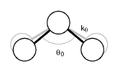
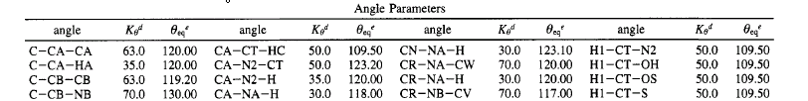

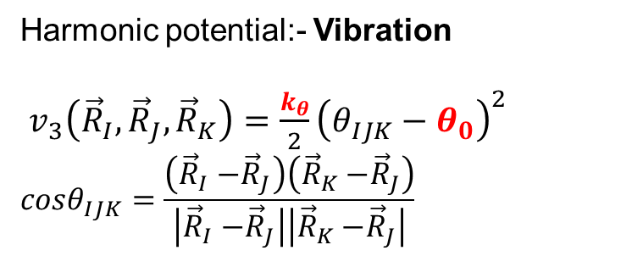

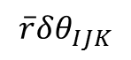

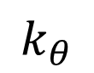
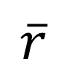
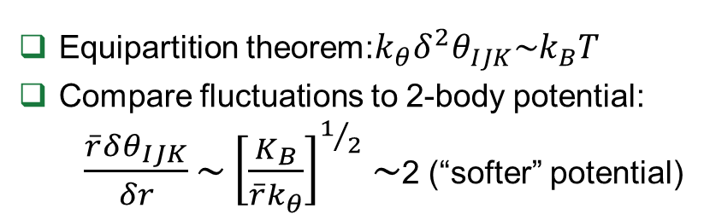
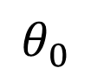
3-body: “angle bending”
Harmonic potential:- Vibration
$v_{3}\left({\vec{R}}_{I},{\vec{R}}_{J},{\vec{R}}_{K}\right)=\frac{k_{θ}}{2}{\left(θ_{IJK}−θ_{0}\right)}^{2}$
$$cosθ_{IJK}=\frac{\left({\vec{R}}_{I}{−\vec{R}}_{J}\right)\left({\vec{R}}_{K}{−\vec{R}}_{J}\right)}{\left|{\vec{R}}_{I}{−\vec{R}}_{J}\right|\left|{\vec{R}}_{K}{−\vec{R}}_{J}\right|}$$
$$J$$
$$k_{θ}$$
$$\overline{r}$$
Equipartition theorem:$k_{θ}δ^{2}θ_{IJK}\sim k_{B}T$
Compare fluctuations to 2-body potential:
$\frac{\overline{r}δθ_{IJK}}{δr}\sim {\left[\frac{K_{B}}{{\overline{r}k}_{θ}}\right]}^{1/2}\sim$2 (“softer” potential)
$$I$$
$$θ_{0}$$
$$K$$
$$\overline{r}δθ_{IJK}$$
Example of parameterization:
(Kcal/mol)

Slide 15
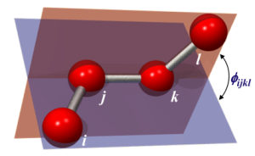
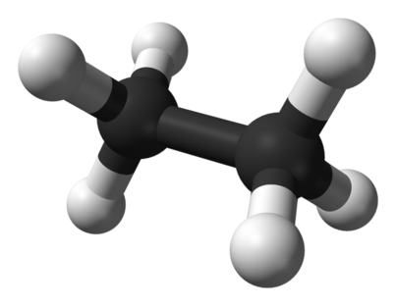
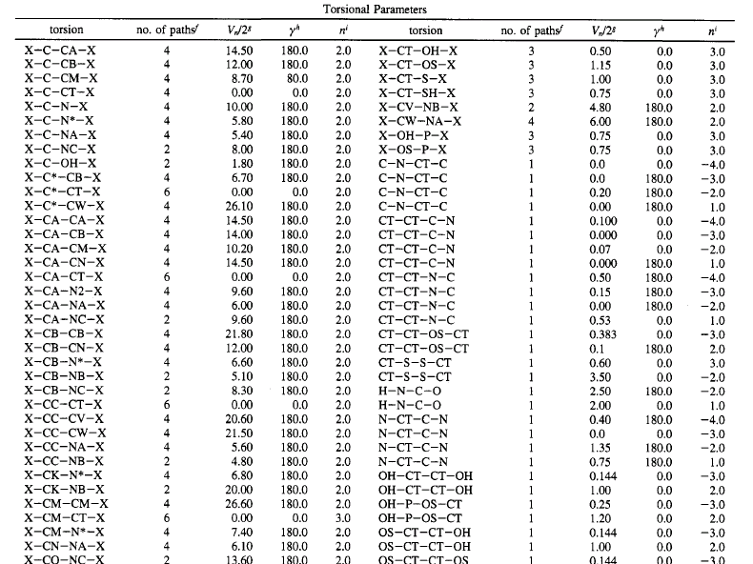
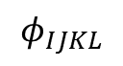
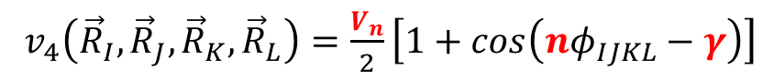
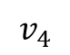
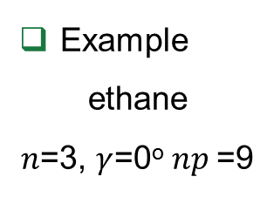
4-body: dihedral torsion
$v_{4}\left({\vec{R}}_{I},{\vec{R}}_{J},{\vec{R}}_{K},{\vec{R}}_{L}\right)=\frac{V_{n}}{2}\left[1+cos\left(nφ_{IJKL}−γ\right)\right]$
Controls localized jump-diffusion
Accounts for most of the configurational entropy of molecules
Example
ethane
$n$=3, $γ$=0º $np$=9
$$v_{4}$$
9 isomeric paths
$$φ_{IJKL}$$
Example of parameterization:

Slide 16
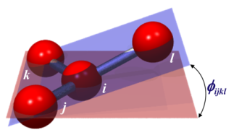
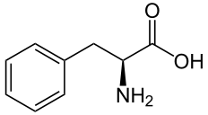
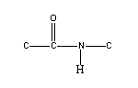
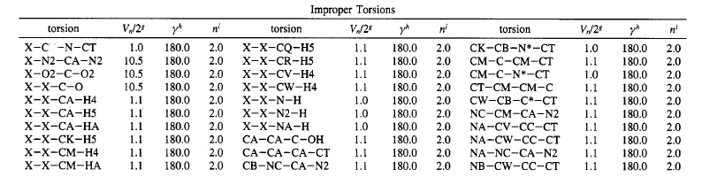
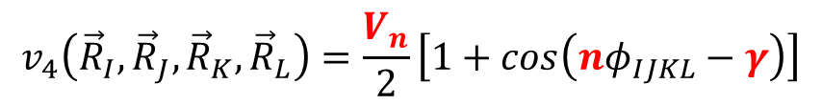
4-body: improper torsions
$$v_{4}\left({\vec{R}}_{I},{\vec{R}}_{J},{\vec{R}}_{K},{\vec{R}}_{L}\right)=\frac{V_{n}}{2}\left[1+cos\left(nφ_{IJKL}−γ\right)\right]$$
Controls localized diffusion
Enforces planarity.
Planar groups such as sp² hybridized carbons in carbonyl groups and in aromatic rings
Example of parameterization:

Slide 17
Exclusions
2-body (bonds), 3-body (angle) and 4-body (torsions) potentials terms implicitly include electrostatics (El) and Van der Walls (VdW) interactions.
Exclude calculation of El and VdW interactions
for 1-2 and 1-3
Partially exclude El and VdW interactions
for 1-4.
VdW scaled by a factor of 0.5
El scaled by a factor of 0.83
2
3
1
4

Slide 18
Introduction to NAMD
SHUG-2015
Jose M. Borreguero
Neutron Data Analysis and Visualization Division
Center for Accelerating Materials Modelling

Slide 19
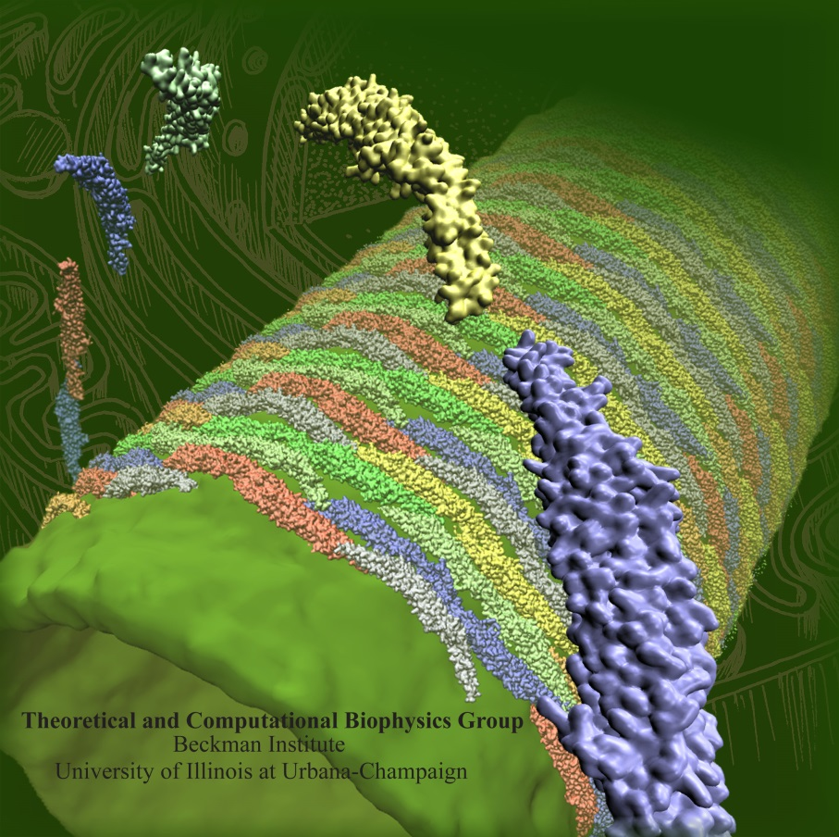
Not (just) Another Molecular Dynamics
http://www.ks.uiuc.edu/Research/namd
Free to use and easy to install
Accepts various popular force fields
AMBER, CHARMM, X-PLOR
Highly efficient when running in parallel
Multiple environments available
different thermodynamic ensembles
external fields defined by user
Complex dynamic schemes
restraints
replicas
free energy calculations

Slide 20
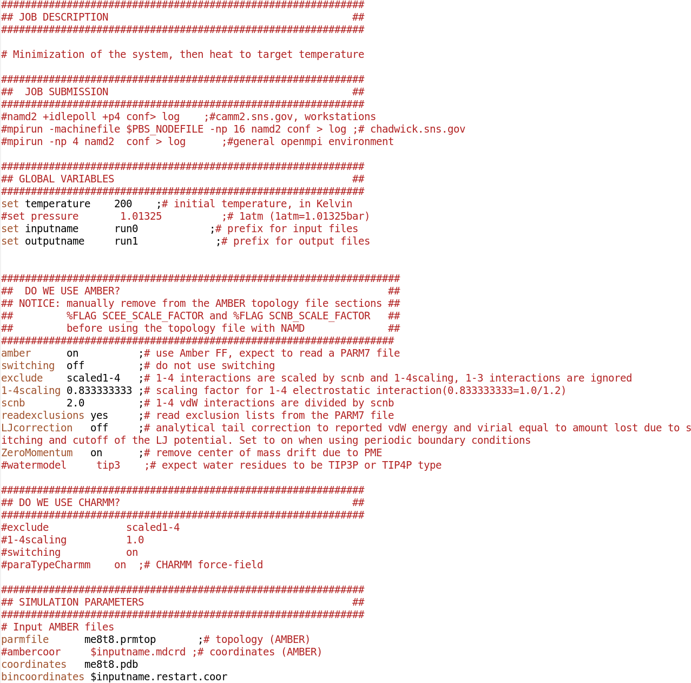
Walkthrough: Input configuration script
Users Guide: http://www.ks.uiuc.edu/Research/namd/2.9/ug

Slide 21
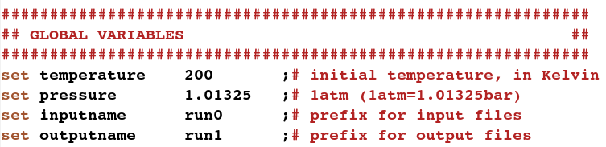
Global variables
You can define as many variables as you want with the set command.
Prepend “$” when calling them.
$temperature
$pressure

Slide 22

Initial system conformation
topology file (.prmtop)
list of bonds
atom types
list of atoms Atom and molecules (.pdb)
coordinates (.coor)
velocities (.vel, not-required in the NVT, NPT ensembles)

Slide 23


Integrator parameters
Pair lists

Slide 24


Temperature control
Pressure control

Slide 25

Output options

